Slide 1

SHRI G.S. INSTITUTE OF SCIENCE AND TECHNOLOGY
Web Engineering : IT38504
GIT & GITHUB
Submitted To:
Dr. Lalit Purohit
Upendra Singh
Submitted By:
Aayush Anand IT-01
Anurag Choubey IT-17
Gunjan Singh IT-30

Slide 2
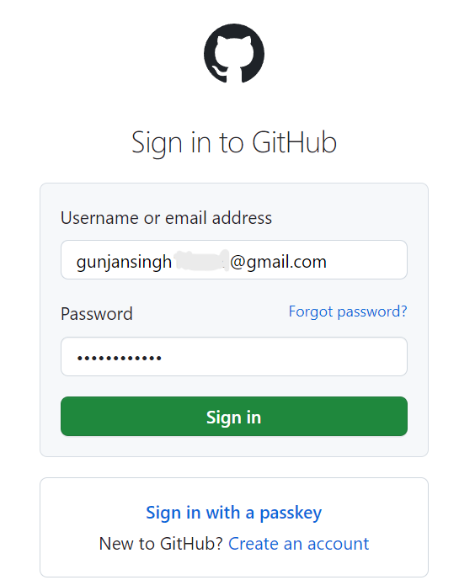

WHAT IS GITHUB AND IT’S INSTALLATION
GitHub is a web-based platform for software developers to collaborate on and control versions of their projects.
The Installation process is described below:
Step 1: Sign in or Sign up to https://github.com/

Slide 3
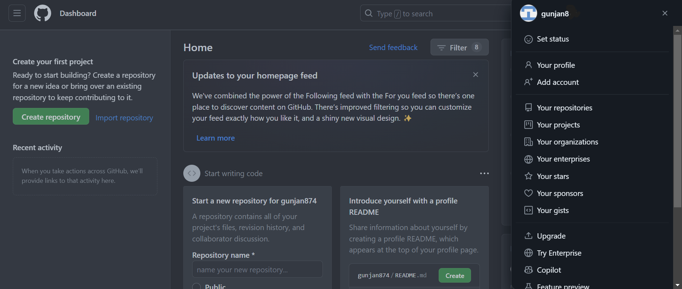
Step 2: The following dashboard will appear after logging in:

Slide 4
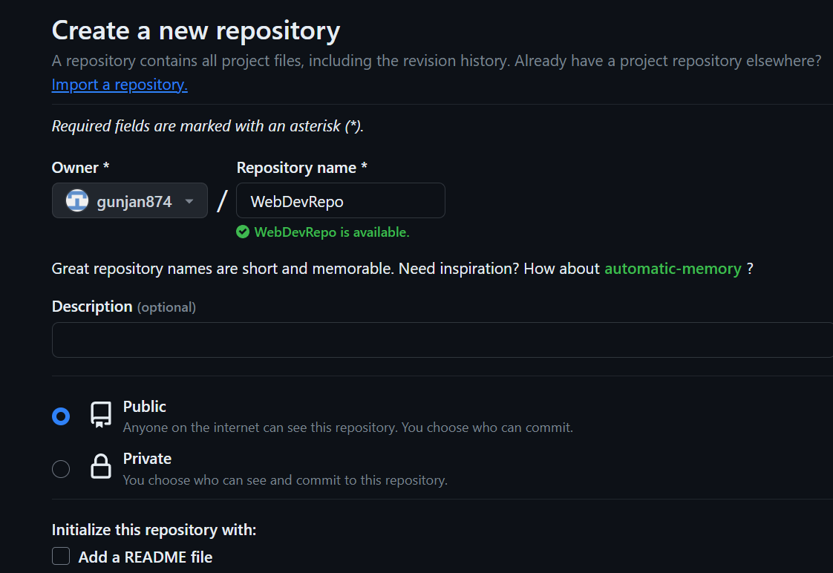
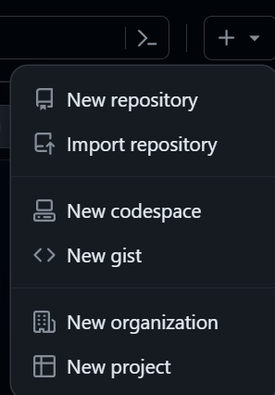
From the Navigation Pane, Select the New repository option

Slide 5
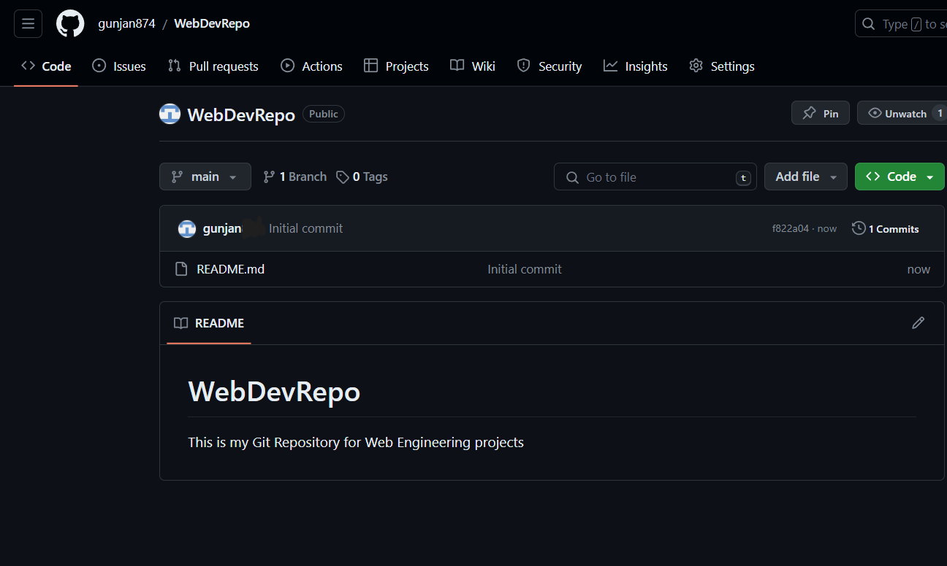
After selecting all the options, one can update the READme file.

Slide 6
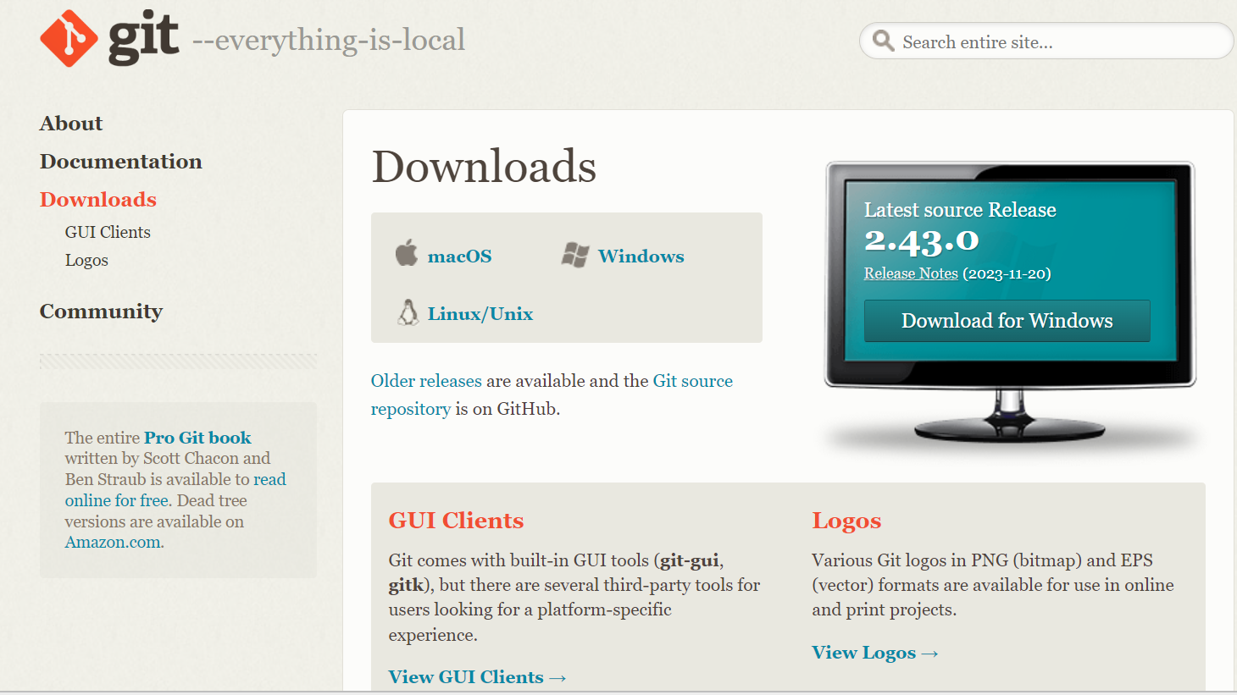
WHAT IS GIT AND IT’S INSTALLATION
Git is a distributed version control system that tracks changes in any set of computer files.
Usually used for coordinating work among programmers who are collaboratively developing source code during software development.
Installation steps for GIT are as follows:
Download the latest version of GIT from https://www.git-scm.com/downloads

Slide 7
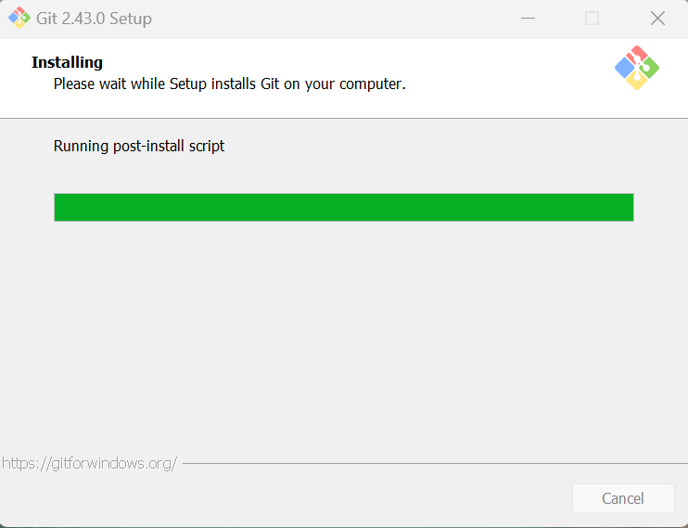
Download the GIT bash according to your OS versions
The Installation once finished, you can configure the Git.

Slide 8
HOW TO CONFIGURE GIT
git config --global user.name “MYname”
Sets the global Git configuration for the user's name to "MYname".
git config --global user.email “xyz..@gmail.com”
Sets the global Git configuration for the user's email to "xyz..@gmail.com".
git config --list
Displays a list of all Git configurations, including user.name and user.email, for the currently configured Git environment.

Slide 9
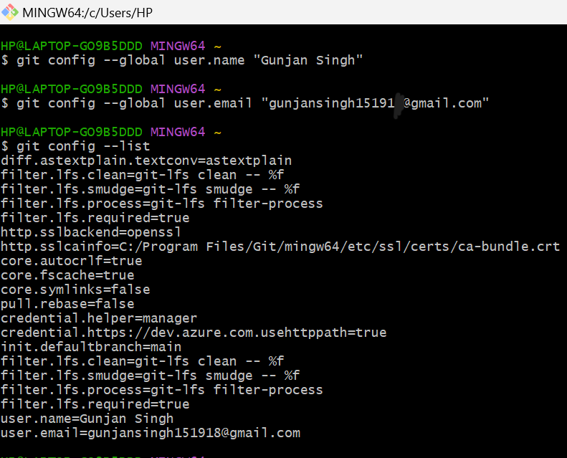

Slide 10
Version Control
-Make save points that save your project.
-Provides total development freedom.
-e.g., git, subversion, perforce.
-Git is a version control tool.
-Github is a service that hosts git repositories.(Collaboration)

Slide 11
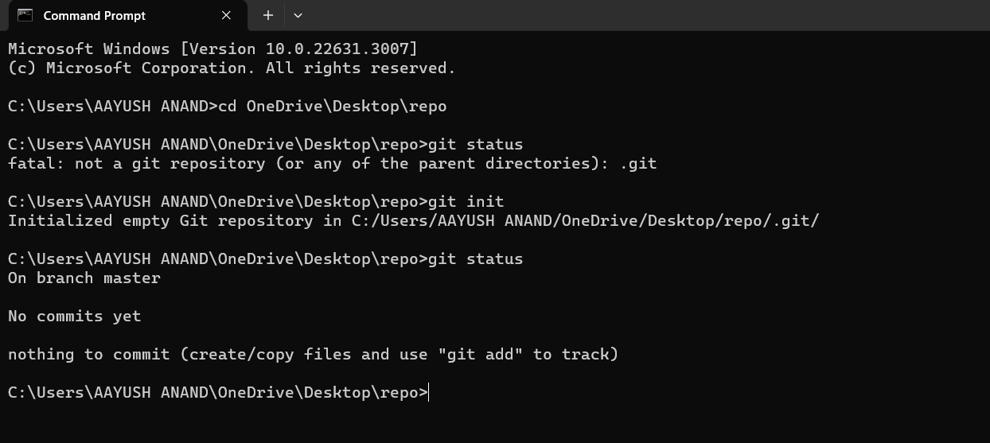
Command : git init
The git init is the first command that you will run on Git.The git init command is used to create a new blank repository.

Slide 12
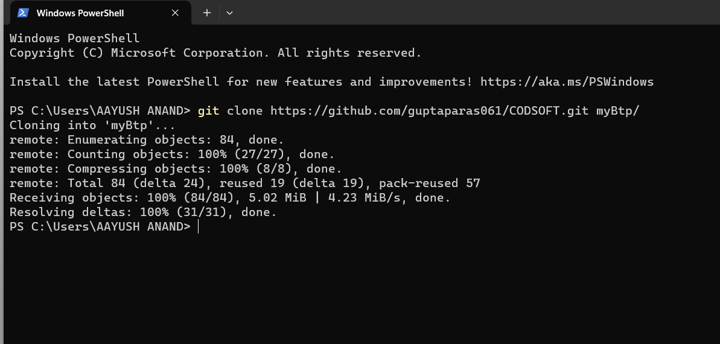
Command : git clone
The git clone is a command line utility which is used to make a local copy of a remote repository. It accesses the repository through a remote URL.

Slide 13
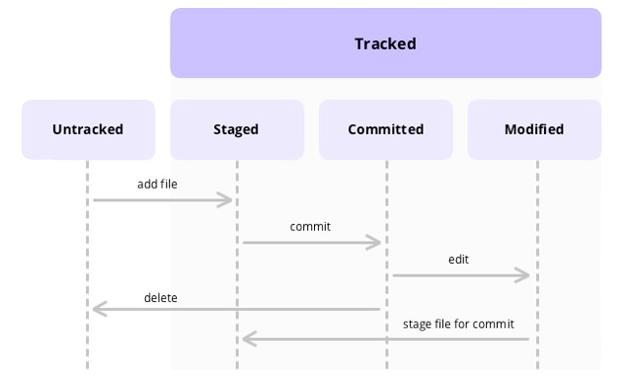
Life Cycle of a Change

Slide 14
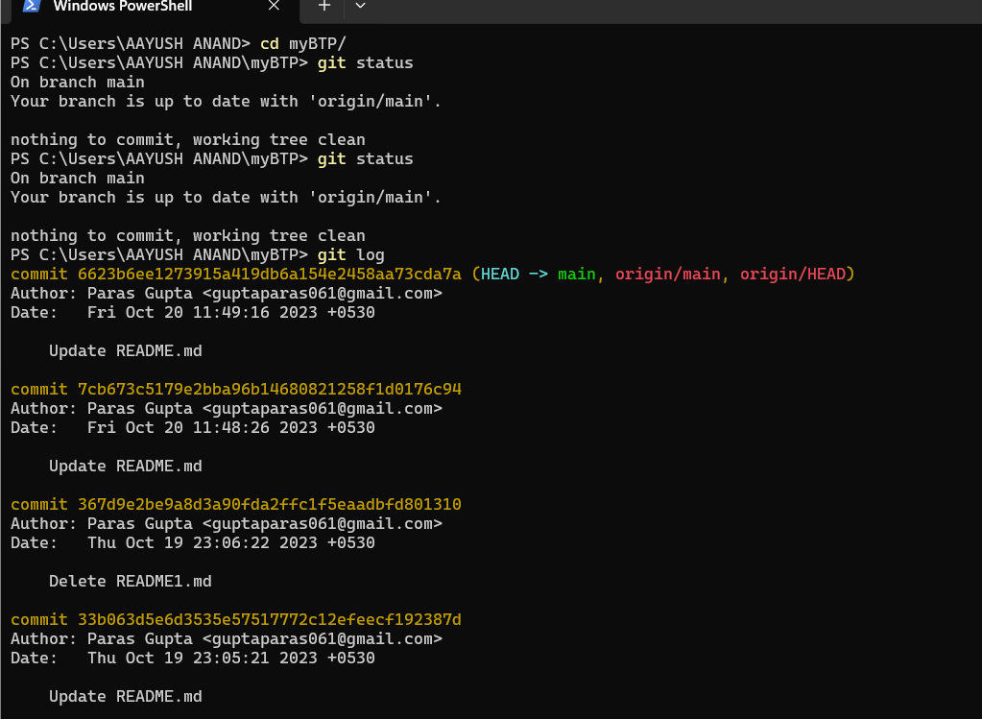
Command : git log
Git log is a utility tool to review and read a history of everything that happens to a repository.

Slide 15
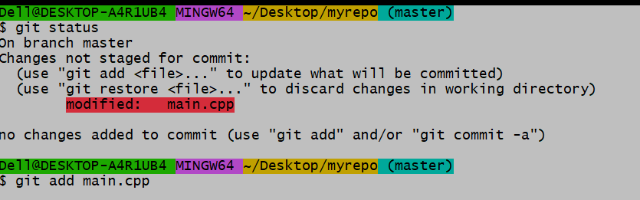
Command : git add <file_name>
The git add command is used to add file contents to the Index (Staging Area).This command updates the current content of the working tree to the staging area. It also prepares the staged content for the next commit.
Some changes are not staged
By using this command we can keep a track on our file

Slide 16
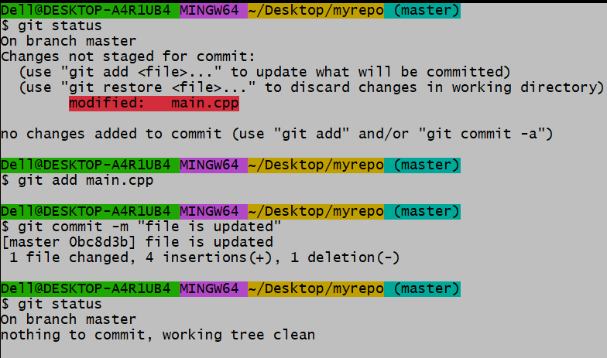
Command : git commit -m “message”
Since we have finished our work, we are ready move from stage to commit for our repo.
All the modifications are committed

Slide 17
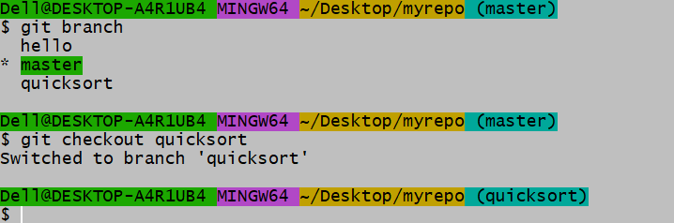
Command : git checkout <branch_ name>
To switch to an existing branch, use the git checkout command followed by the branch name
Existing branches
Switched to another branch

Slide 18
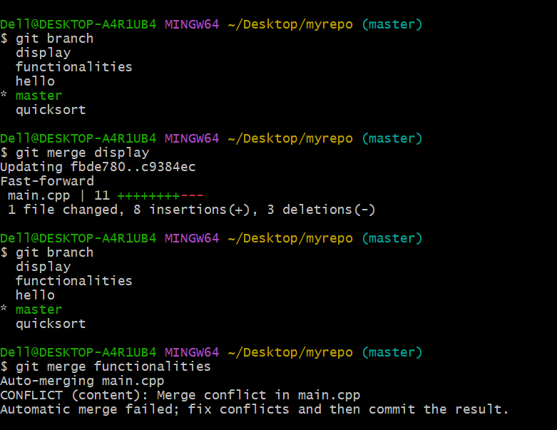
Command : git merge
Git merge will help to combine the changes from two or more branches into a single branch. Developers will work on different branches to improve code or to develop the code after completion we can merge them into a single version of the code.

Slide 19
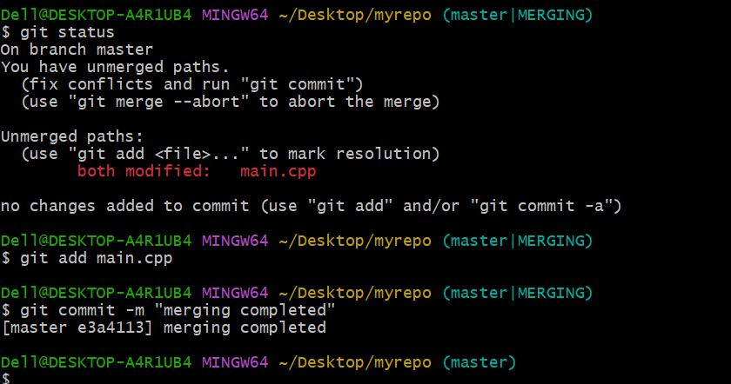

Slide 20
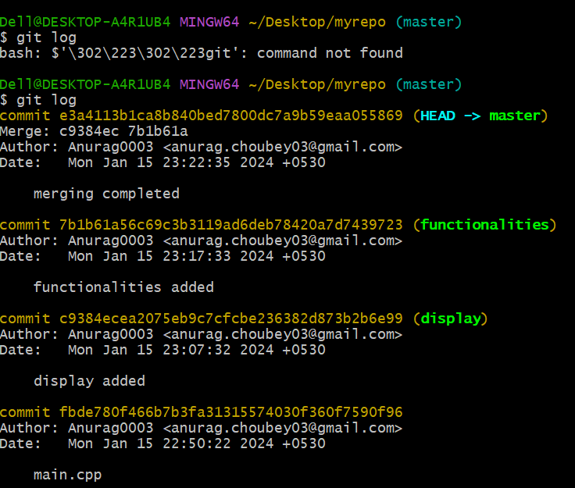
Command : git revert <commit_id>
The git revert command is a forward-moving undo operation that offers a safe method of undoing changes
Copy this ID
This commit needs to be reverted

Slide 21
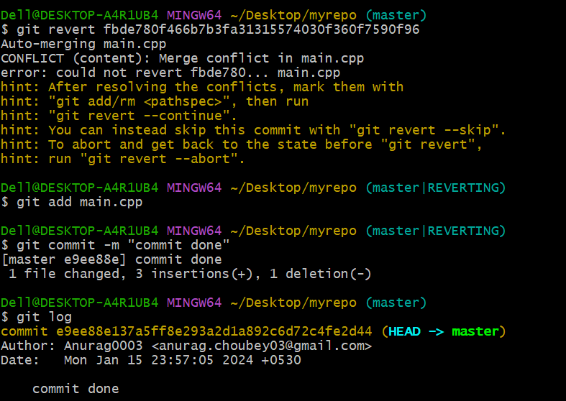
Resolving conflict
Then making final commit

